Slide 1
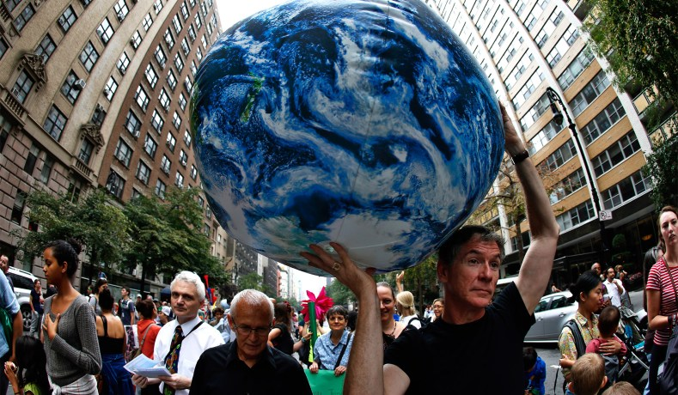

How is the climate crisis affecting China?
Students from College of Environmental Science and Engineering, Peking University
2021/11/09

Slide 2

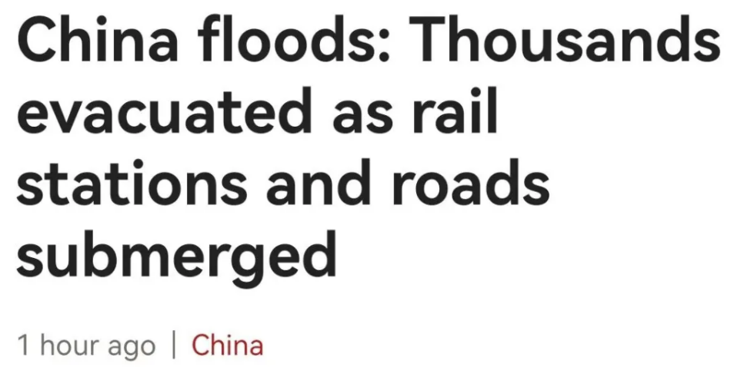
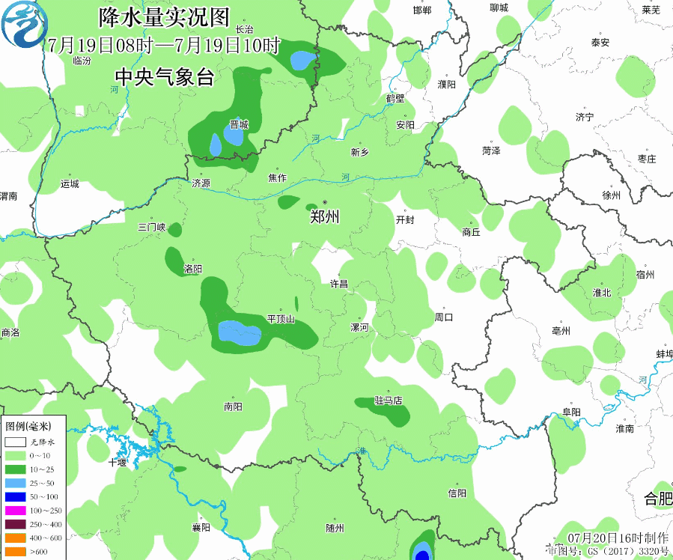
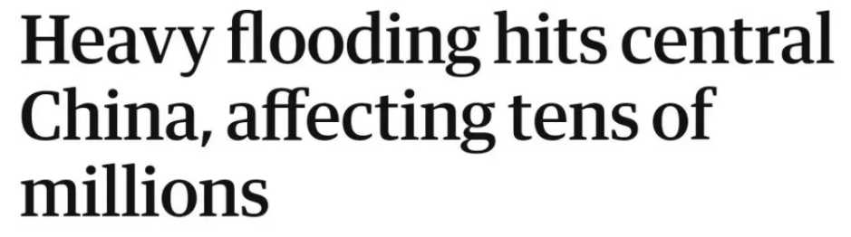
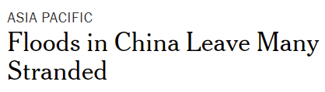

Background
Extreme Rainfall in Zhengzhou
Related News
From 18:00 on July 18th to 0:00 on July 21st, 2021, a rare and sustained heavy precipitation occurred in Zhengzhou, Henan province. In three days, an entire year’s-worth of rain fell on this city.
BBC
From 16:00 to 17:00 on July 20th, 2021, the rainfall in Zhengzhou reached 201.9 mm in one hour.
National Meteorological Centre
Guardian
More than 100 West Lakes poured into Zhengzhou in one hour
Zhengzhou
New York Times
Fig 1: Precipitation GIF from July 19th to 20th

Slide 3
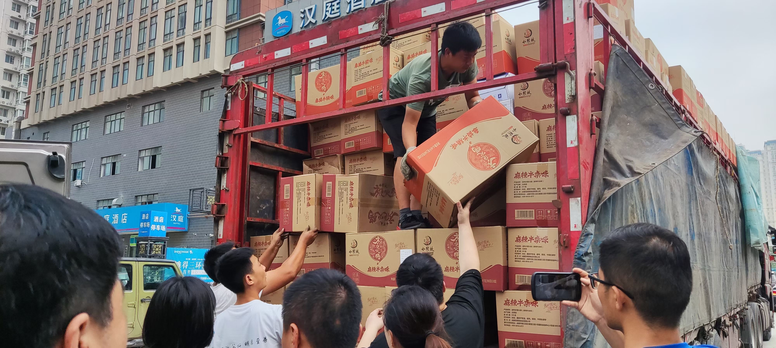
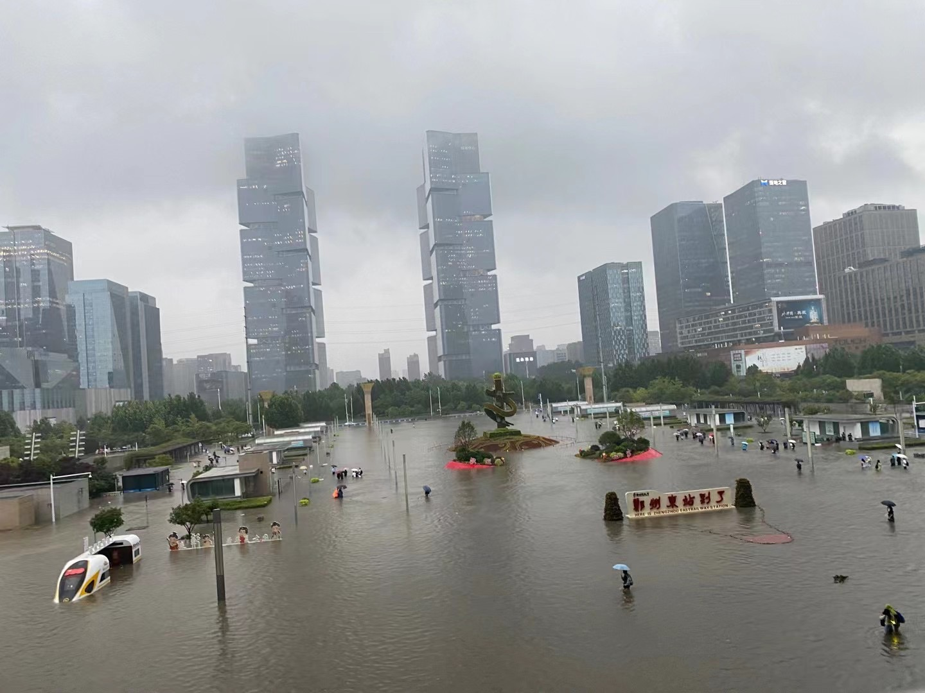

Background
Extreme Rainfall in Zhengzhou
Here are some photos pictured by one of my friends when he was stuck in Zhengzhou.
B: Life supplies delivered to Zhengzhou
A: View from Zhengzhou East High-speed Railway Station
C: Volunteers played a very important role

Slide 4
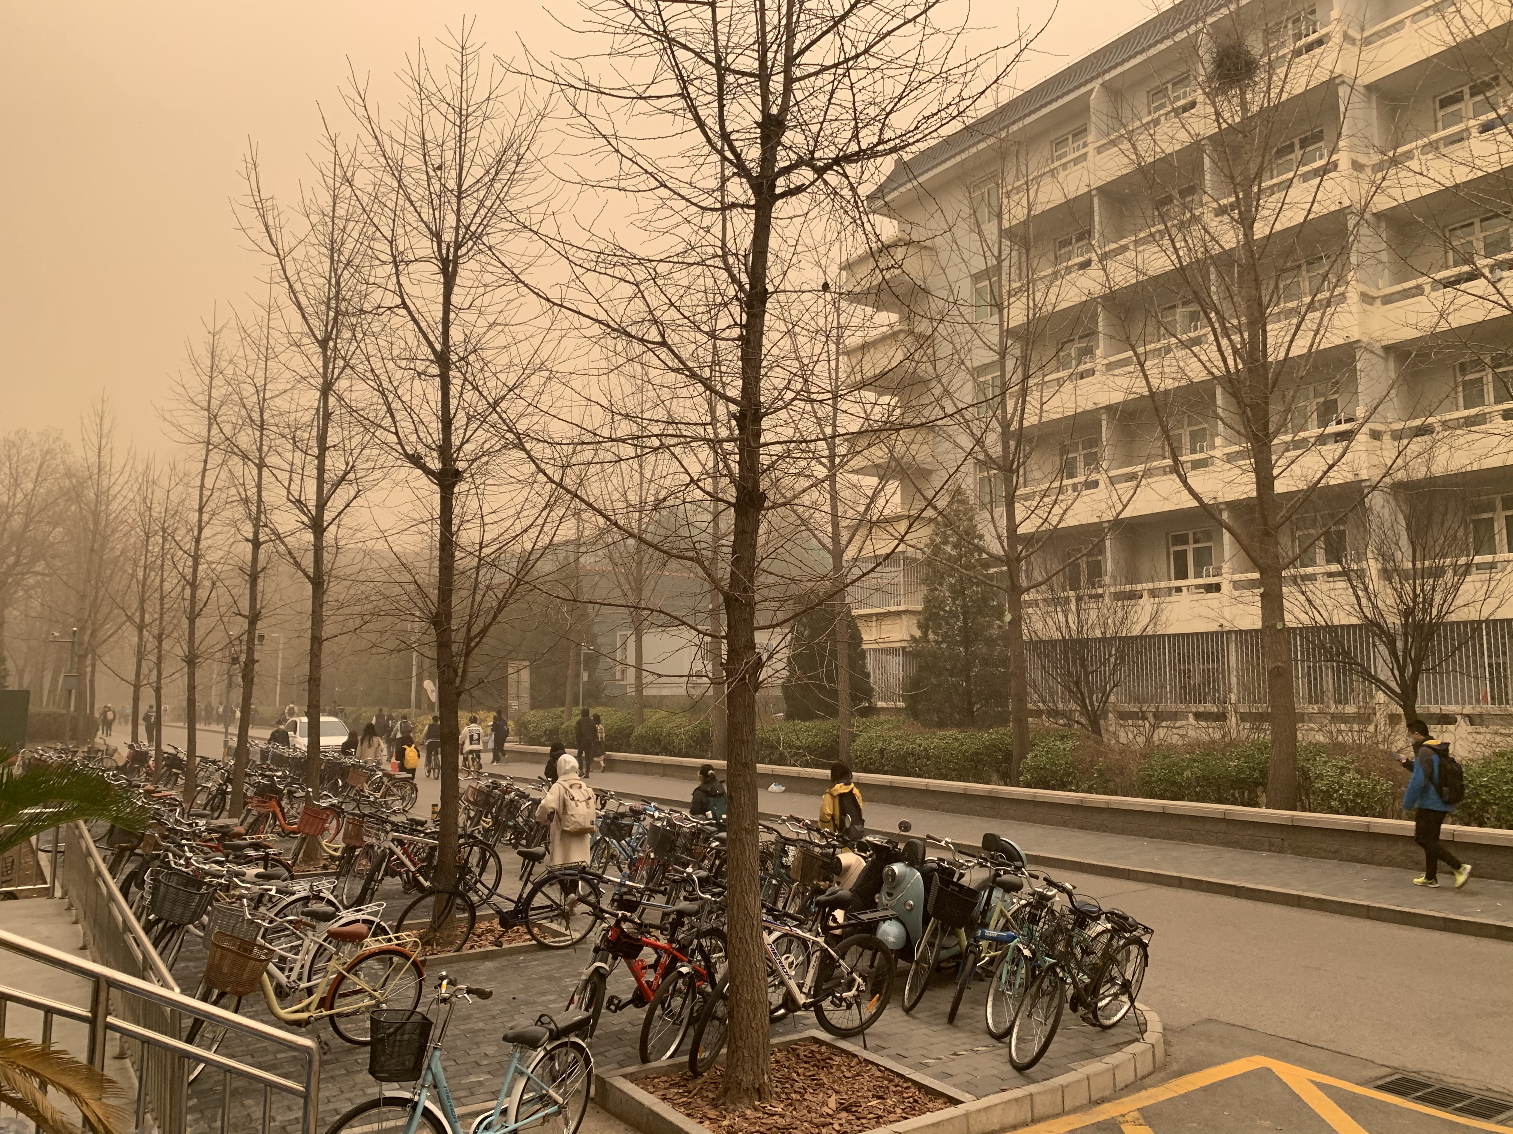
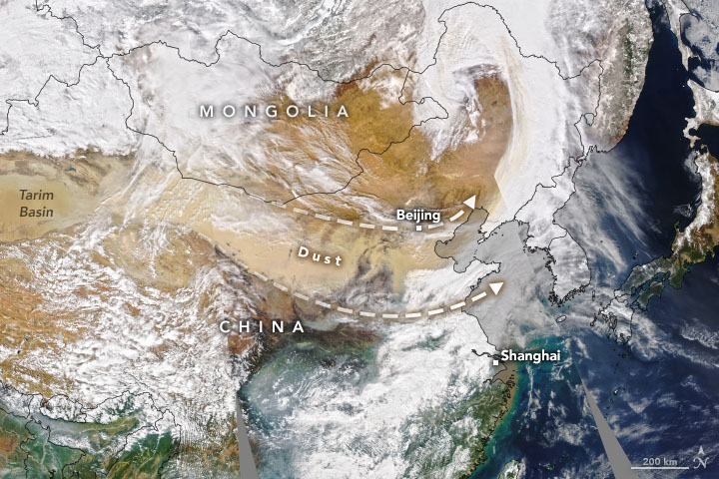

Background
Experience in Beijing
PM₁₀ concentrations in most areas exceeded 2000 μG/m3
SANDSTORM
A sandstorm that hit Beijing in March pushed air pollution levels off the charts, turned the sky yellow and reduced the sun to a blue dot.
Thick dust carrying extremely high levels of hazardous particles blows in from drought-hit Mongolia.
A photo on March 15th 2021, on PKU campus
“It’s of the greatest intensity over 10 years!”
Fig 2: a natural-color image shows trajectory of dust (NASA)

Slide 5
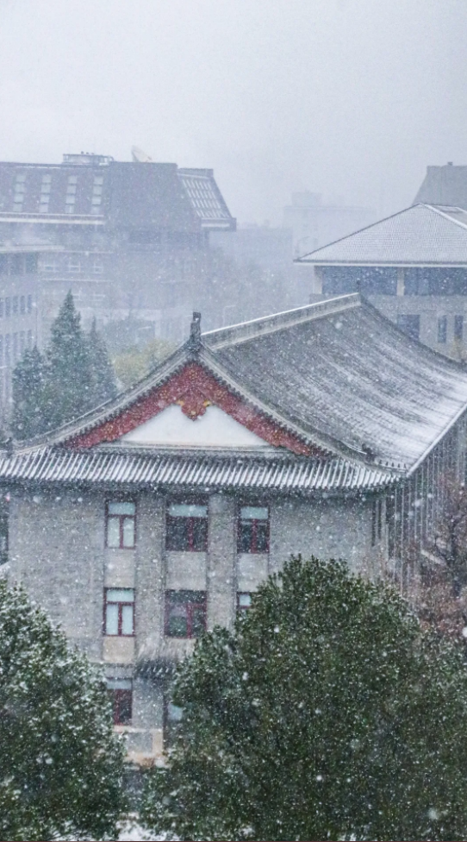
Background
Experience in Beijing
Extreme cold
2021.1.7: -19.6 ℃, the second lowest winter temperature since 1951
2021.10.17: -0.2 ℃ ,the lowest since 1969. The first temperature below zero was 20 days earlier.
2021.11.6: first snow, which is much earlier than last year (11.21)
Extreme rainfall
Long Flood season 122 DAYS
Strong
1. 10 times over 25 mm/d, 2 times over 50 mm/d
2. 792mm, 90% higher than annual data, 70% higher than the data in recent 10 years
3. 400.4mm in July, the most since monitoring began（1951）
PKU campus shrouded in the snow

Slide 6
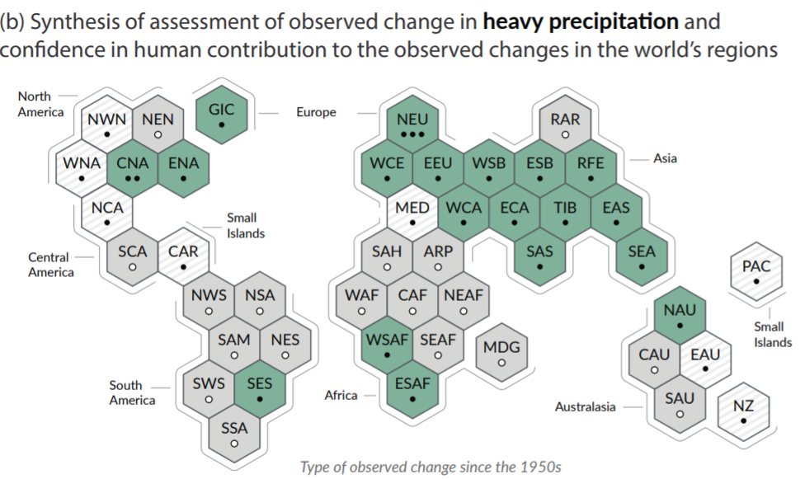
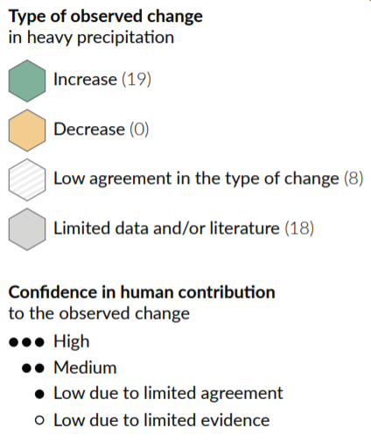
Changes in heavy precipitation in the world
China is here
Source: The Sixth Assessment Report of the Intergovernmental Panel on Climate Change

Slide 7
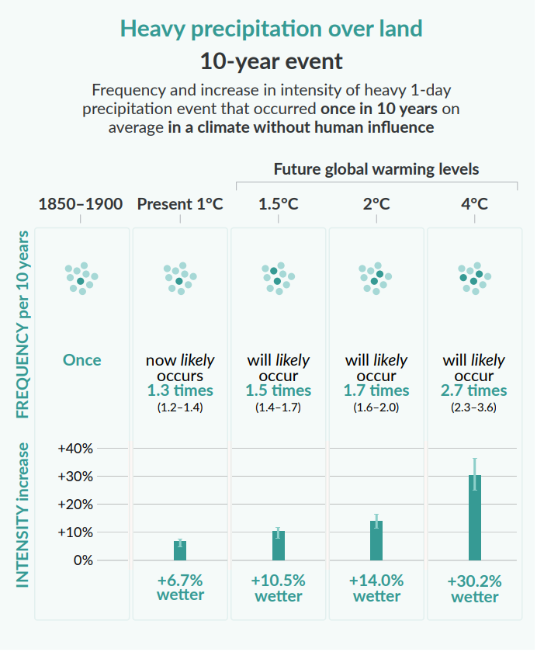
Heavy precipitation
(frequency and intensity)
Projected changes are shown at global warming levels of 1°C, 1.5°C, 2°C, and 4°C and are relative to 1850–1900,9 representing a climate without human influence. The figure depicts frequencies and increases in intensity of 10- or 50-year extreme events from the base period (1850–1900) under different global warming levels.
Extreme precipitation events are defined as the daily precipitation amount over land that was exceeded on average once in a decade during the 1850–1900 reference period.
Source: The Sixth Assessment Report of the Intergovernmental Panel on Climate Change

Slide 8
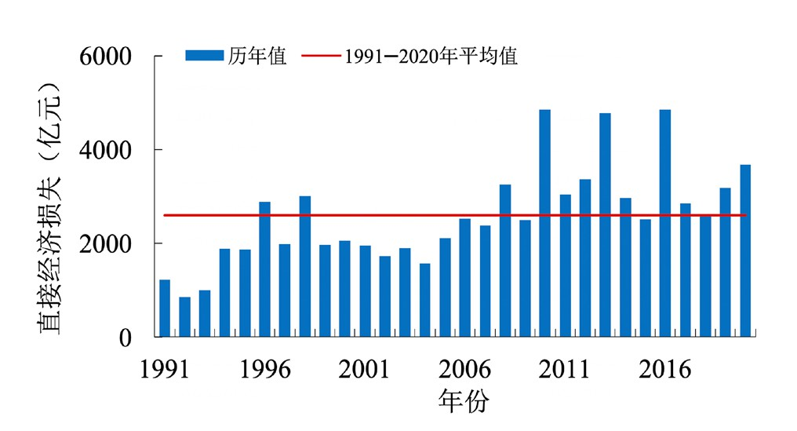
Economic Issue
Direct GDP loss(100 million yuan)
Extreme weather
Bring greater economic costs
Financial system
Physical risks associated with economic losses caused by climate related events
Transformation risks associated with revaluation of carbon intensive assets
Agricultural sector
probably one of the most sensitive sectors to climate change
The blue bar here means the loss annually and the red line means the average loss over the last 30 years (Units: One hundred million yuan)
Features of extreme weather:
Wide variety
high frequency
long duration
strong seasonality
obvious regionality
In 2020, the direct economic loss reached
368.1 billion yuan

Slide 9
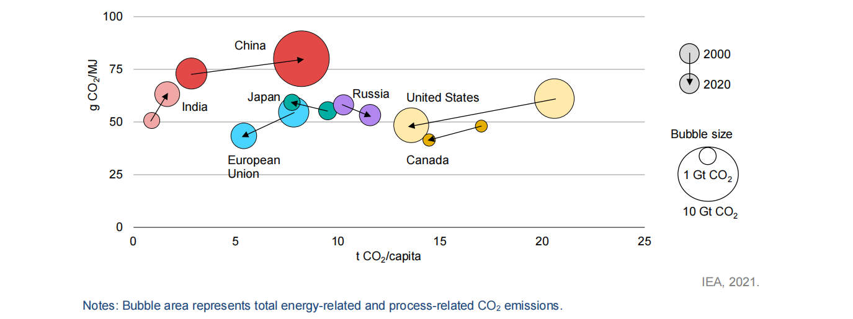
Economic Issue
CO₂ emissions intensity of primary energy demand relative to CO2 emissions per capita by country/region, 2000 and 2020
Despite impressive growth in renewables since 2000, China remains heavily dependent on fossil fuels, with coal alone still meeting 60% of its total primary energy needs.

Slide 10
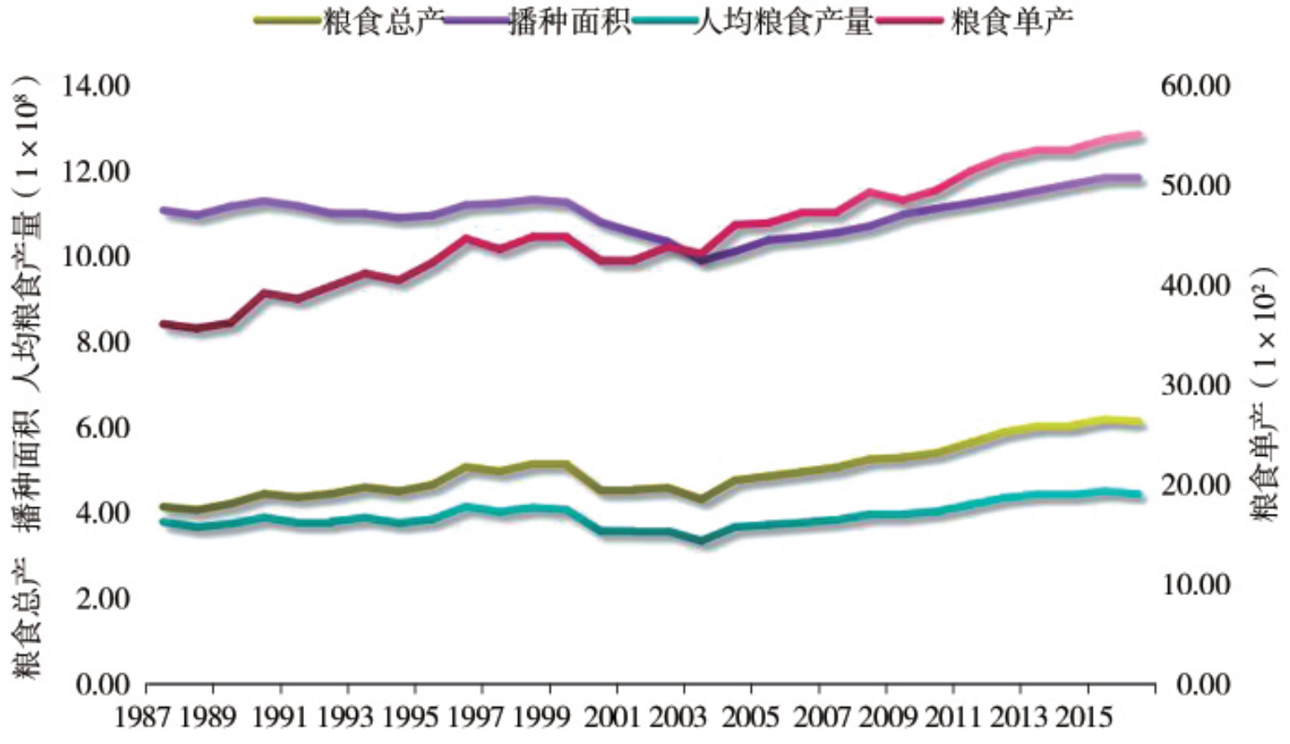
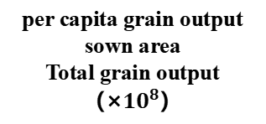
Agriculture Issue
per capita grain output
sown area
Total grain output
（×${10}^{8}$）
grain yield per unit area（×100）
sown area
China's agriculture accounts for 9% of the world's arable land, yet it provides food and clothing for 20% of the world's population!
grain yield per unit area
total grain output
per capita grain output
Development and changes of China's grain production
Reference： WEN Jing, ZHANG Chao, et. al. Spatio temporal Evolution and Influencing Factors of Chinese Grain Production under Climate Change. Journal of Henan University(Natural Science). 2020: 50(6).

Slide 11
Agriculture Issue
Many diseases and pests began to evolve a unique hibernation mechanism, and the survival time gradually increased
Many of the northern diseases and insects were brought to the south without corresponding natural enemies to contain them
plant diseases
&
insect pests
Large-scale precipitation will cause landslides and mountain floods, resulting in the breach of the reservoir dike
Extreme droughts can reduce crop yields
Climate Change
extreme weather
Example: Since the 1990s, the climate in northeast China has changed significantly, and rice can no longer be grown in some areas, while the planting range of warm-loving plants in northwest China has expanded.
light resources; Planting area and system……
Reference： XIE Wei, WEI Wei,CUI Qi.The impacts of climate change on the yield of staple crops in China: a Meta-analysis[J]. China population,resources and environment,2019,29(1):79-85．

Slide 12
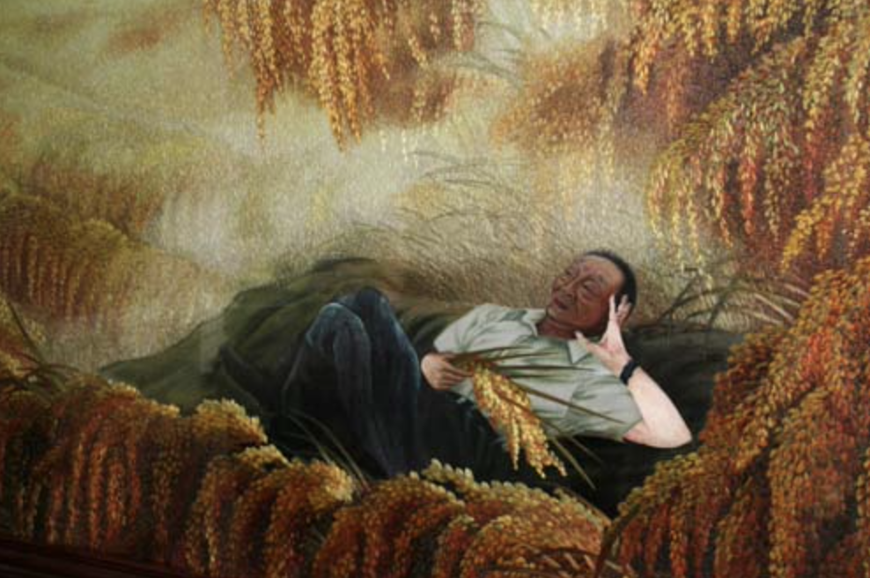
Agriculture Issue
China is making great efforts in agricultural production to mitigate the impact of global climate change on food production.
Academician Yuan Longping (1930.9-2021.5)
"Father of Hybrid Rice"
“I have two dreams:
The dream of enjoying the cool under the grain.
The dream of covering the world with hybrid rice.”
For People in China,
for People of the World.
On October 26, 2021, nanfan public experimental base in Sanya city, Hainan province announced the results of double season rice yield measurement: Hainan has achieved the goal of 1500 kg per unit area of double season rice, creating the highest local double season rice yield per mu record!

Slide 13
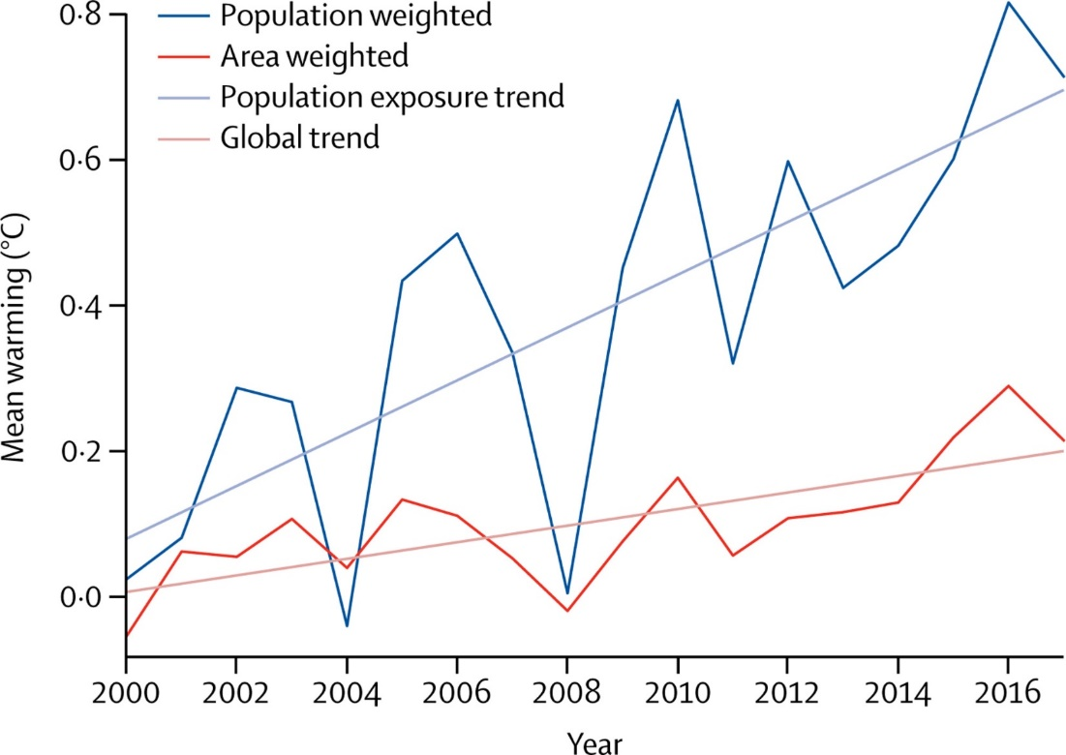
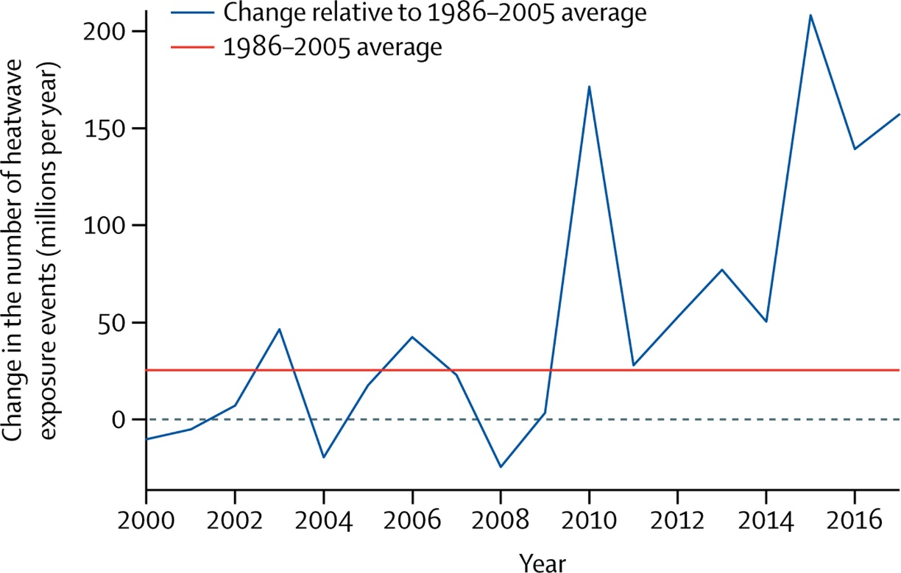
Health Issue
In 49 large cities in the United States, changes in extreme hot and extreme cold temperatures are projected to result in more than 9,000 additional premature deaths per year under a higher scenario by the end of the century.
Mean summer warming relative to the 1986–2005 average
Change in the number of heatwave exposure compared with the historical average number of events (1986–2005 average)
Reference：Watts, Nick, et al The 2018 report of the Lancet Countdown on health and climate change: shaping the health of nations for centuries to come[J]. The Lancet, 2018.

Slide 14
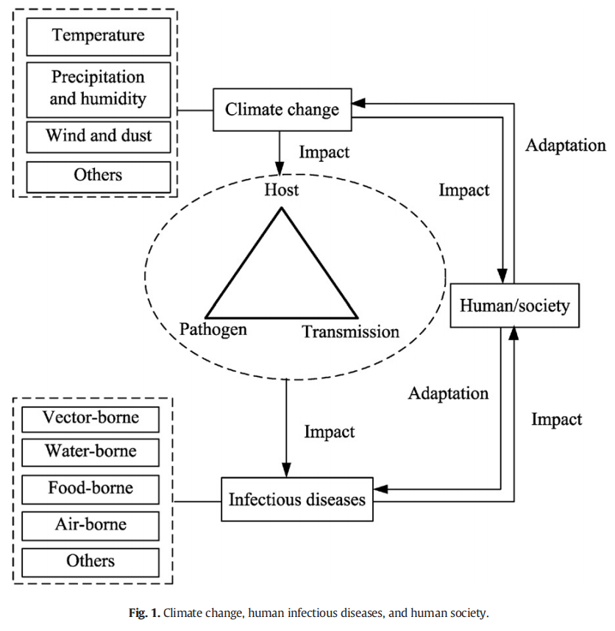
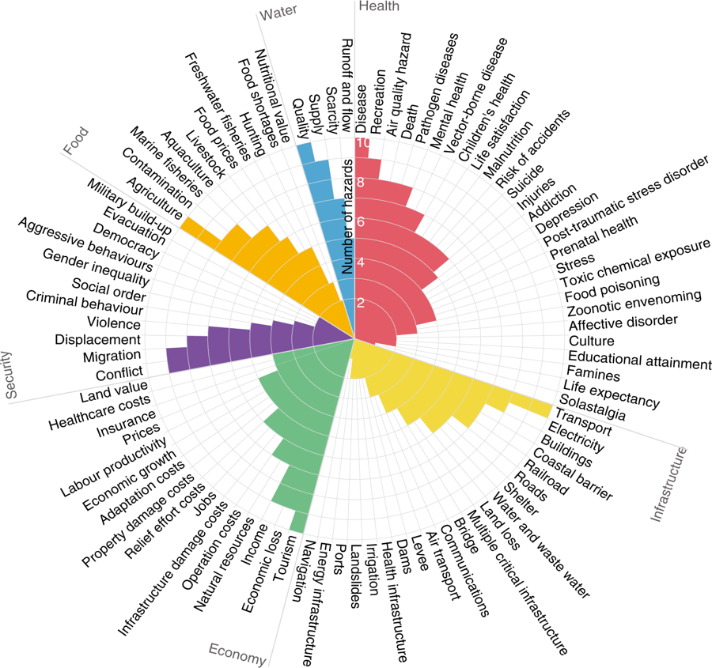
Health Issue
Ten Climate Hazards And six aspects of human systems
Reference：Impact of climate change on human infectious diseases: Empirical evidence and human adaptation

Slide 15
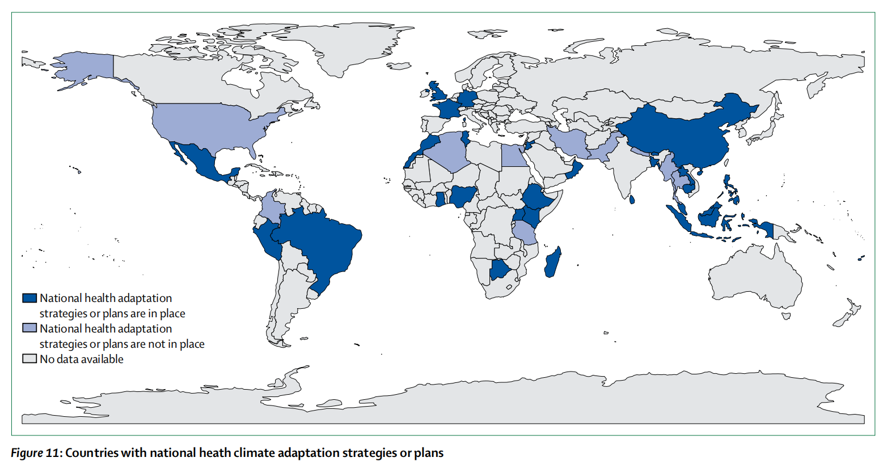
Adaptation
·Some countries have taken national health climate adaptation strategies or plans.
Reference：The Lancet Countdown on health and climate change: from 25 years of inaction to a global transformation for public health

Slide 16
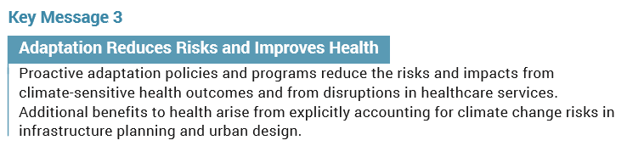
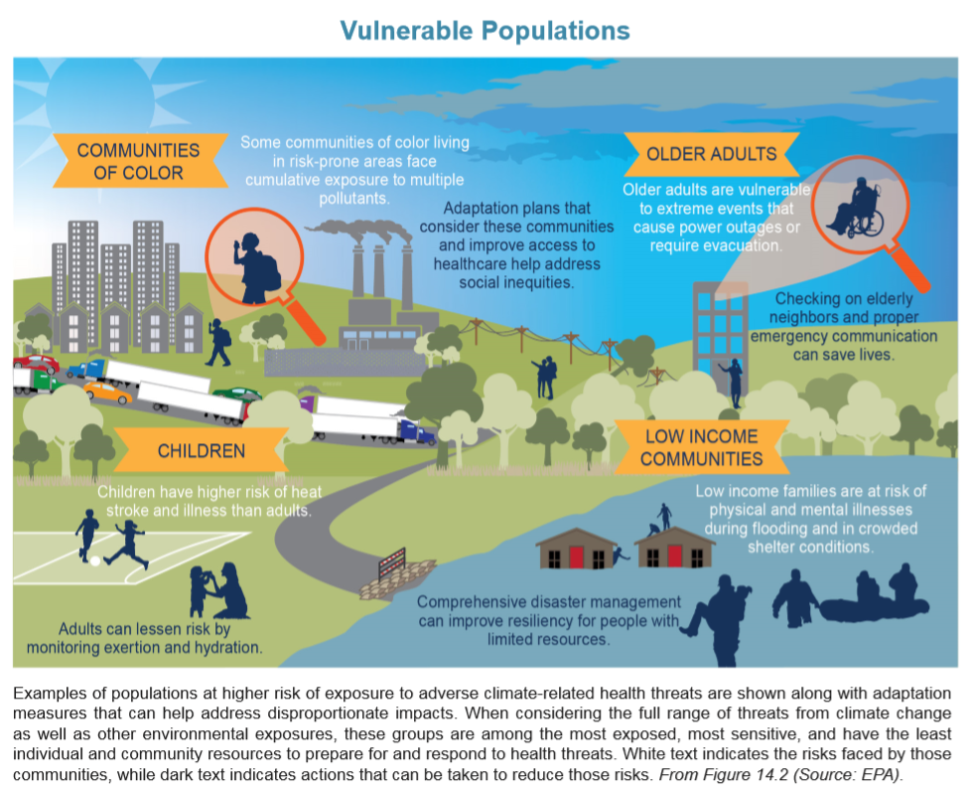
Adaptation
Local efforts including:
Altering urban design (for example, by using cool roofs, tree shades, and green walkways)
Improving water management (for example, via desalination plants or watershed protection)
can provide health and social justice benefits, elicit neighborhood participation, and increase resilience for specific populations, such as outdoor workers.
Reference: US Fourth National Climate Assessment

Slide 17
Thanks!

